Slide 1

Unit 4 - PLANNING

Slide 2
Planning and Learning Table of Contents
Planning- Planning problems, Simple planning agent, Planning languages
Blocks world ,Goal stack planning, Mean Ends Analysis
Non-linear Planning, Conditional planning, Reactive planning
Learning- Machine learning, Goals and Challenges of machine learning
Learning concepts, models, Artificial neural network based learning- Back propagation, Support vector machines,
Reinforcement learning, Adaptive learning, Multi_agent based learning, Ensemble learning, Learning for decision making, Distributed learning, Speedup learning

Slide 3
Planning
Find a sequence of actions that achieves a given goal when executed from a given initial world state.
That is, given
a set of operator descriptions (defining the possible primitive actions by the agent),
an initial state description, and
a goal state description or predicate,
compute a plan, which is a sequence of operator instances, such that executing them in the initial state will change the world to a state satisfying the goal-state description.
Goals are usually specified as a conjunction of subgoals to be achieved

Slide 4
Planning vs. Problem Solving
Planning and problem solving methods can often solve the same sorts of problems
Planning is more powerful because of the representations and methods used.
States, goals, and actions are decomposed into sets of sentences (usually in first-order logic)
Search often proceeds through plan space rather than state space (though there are also state-space planners)
Subgoals can be planned independently, reducing the complexity of the planning problem

Slide 5
Planning Problem
Get tea, biscuits, and a book.
Given:
 Initial state: Initial state: The agent is at home without tea, biscuits, book
 Goal state: Goal state: The agent is at home with tea, biscuits, book biscuits, book

Slide 6
Planning Problem
States can be represented by predicates States can be represented by predicates such as
At(x), Have(y), Sells(x, y) At(x), Have(y), Sells(x, y)
 Actions:
 Go(y) : Agent goes to y
– causes At(y) to be true
 Buy(z): Agent buys z
– causes Have(z) to be true
 Steal(z): Agent steals z

Slide 7
Planning Problem
Actions are given as logical descriptions of preconditions and effects.
This enables the planner to make direct connections between states and actions. connections between states and actions.
The planner is free to add actions to the plan wherever they are required, rather than in an wherever they are required, rather than in an incremental way starting from the initial state. incremental way starting from the initial state.
Most parts of the world are independent of most other parts most other parts – hence divide & conquer hence divide & conquer works well.

Slide 8
Situation Calculus
Initial state:
At(Home, s0) ∧ ¬ Have(Tea, s0) ∧ ¬ Have(Biscuits, s0) ∧ ¬Have(Book, s0)
Goal state:
∃ s At(Home, s) ∧ Have(Tea, s) ∧ Have(Biscuits, s) ∧ Have(Book, s)
Operators:
∀ a,s Have(Tea, Result(a,s)) ⇔ [(a = Buy(Tea) ∧ At(Tea-shop,s))
∨ (Have(Tea, s) ∧ a ≠ Drop(Tea))]
Result(a,s) names the situation resulting from executing the action a in the situation s

Slide 9
Simple Planning Agent
Use percepts to build model of current world state
IDEAL-PLANNER: Given a goal, algorithm generates plan of action
STATE-DESCRIPTION: given percept, return initial state description in format required by planner
MAKE-GOAL-QUERY: used to ask KB what next goal should be

Slide 10
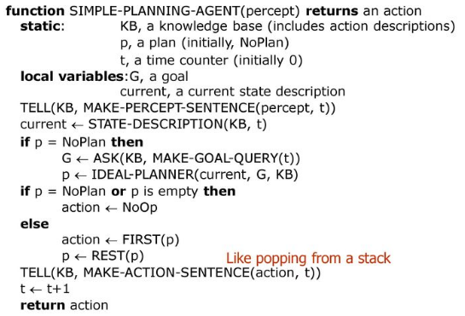
A Simple Planning Agent

Slide 11
Planning Languages
To represent planning problems we use Artificial Intelligence planning languages that describe environment’s conditions which then lead to desired goals by generating chain of actions based on these conditions.
STRIPS (STanford Research Institute Problem Solver) -an action language which was a part of the first major planning system with the same name.
ADL (Action Description Language) is one of STRIPS extension which supports negative literals, quantified variables in goals (e.g. ∃x At (P1, x) ∧ At(P2, x)), conditional effects and disjunctions in goals (all not allowed in STRIPS)
PDDL (Planning Domain Definition Language). - an attempt to standardize planning languages (STRIPS, ADL and much more other representational languages)

Slide 12
Planning and Learning Table of Contents
Planning- Planning problems, Simple planning agent, Planning languages
Blocks world ,Goal stack planning, Mean Ends Analysis
Non-linear Planning, Conditional planning, Reactive planning
Learning- Machine learning, Goals and Challenges of machine learning
Learning concepts, models, Artificial neural network based learning- Back propagation, Support vector machines,
Reinforcement learning, Adaptive learning, Multi_agent based learning, Ensemble learning, Learning for decision making, Distributed learning, Speedup learning

Slide 13
Blocks World Problem(Planning)
What is the Blocks World? -- The world consists of:
A flat surface such as a tabletop
An adequate set of identical blocks which are identified by letters.
The blocks can be stacked one on one to form towers of apparently unlimited height.
The stacking is achieved using a robot arm which has fundamental operations and states which can be assessed using logic and combined using logical operations.
The robot can hold one block at a time and only one block can be moved at a time.

Slide 14
Blocks World Problem(Planning)
We shall use the four actions:
UNSTACK(A,B)-- pick up clear block A from block B;
STACK(A,B)-- place block A using the arm onto clear block B;
PICKUP(A)-- lift clear block A with the empty arm;
PUTDOWN(A)-- place the held block A onto a free space on the table.
and the five predicates:
ON(A,B)-- block A is on block B.
ONTABLE(A)-- block A is on the table.
CLEAR(A)-- block A has nothing on it.
HOLDING(A)-- the arm holds block A.
HANDEMPTY-- the arm holds nothing

Slide 15
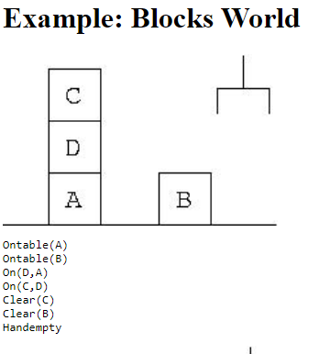
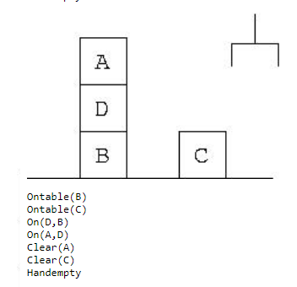
The Planning System Strips
initial state Init (given by predicate logical formulae)
goal state goal (given by predicate logical formulae)
set of rules (given by name, preconditions, delete list, & add list )
Initial State
Goal State

Slide 16
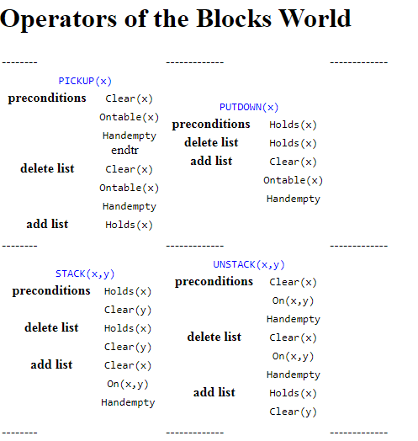
The Planning System Strips

Slide 17
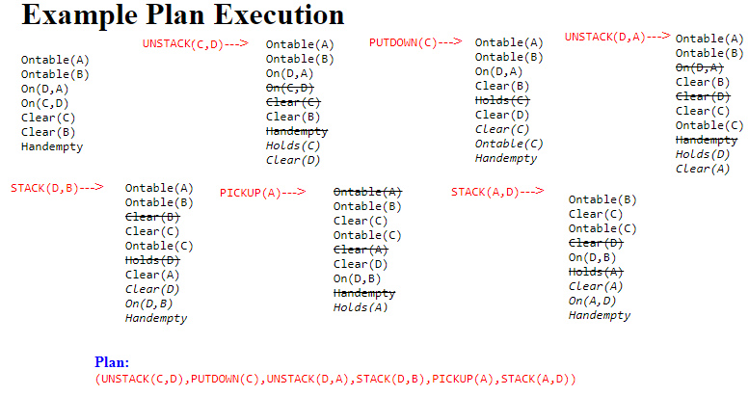
The Planning System Strips

Slide 18
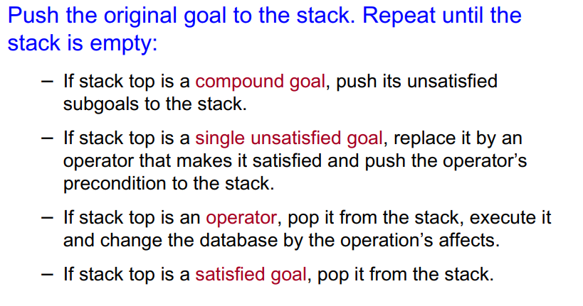
Goal Stack Planning

Slide 19

GOAL STACK PROBLEM
Problem solver relies on
A database that describes the current situation.
Set of operators with precondition, add and delete lists.
Let us assume that the goal to be satisfied is:
GOAL = G1 ^ G2 ^ … ^Gn
Sub-goals G1, G2, … Gn are stacked with compound goal G1 ^ G2 ^ …^ Gn at the bottom.
Top G1
G2
:
Gn
Bottom G1 ^ G2 ^ … ^ G4
At each step of problem solving process, the top goal on the stack is pursued.

Slide 20
GOAL STACK PROBLEM- The Idea!
Place goal in goal stack:
Goal1
Considering top Goal1,
place onto it its sub-goals:
GoalS1-2
GoalS1-1
Goal1
Then try to solve sub-goal
GoalS1-2, and continue…

Slide 21
GOAL STACK PROBLEM - ALGORITHM
Algorithm
Find an operator that satisfies sub goal G1 (makes it true) and replace G1 by the operator.
If more than one operator satisfies the sub goal then apply some heuristic to choose one.
In order to execute the top most operation, its preconditions are added onto the stack.
Once preconditions of an operator are satisfied, then we are guaranteed that operator can be applied to produce a new state.
New state is obtained by using ADD and DELETE lists of an operator to the existing database.
Problem solver keeps tract of operators applied.
This process is continued till the goal stack is empty and problem solver returns the plan of the problem.

Slide 22
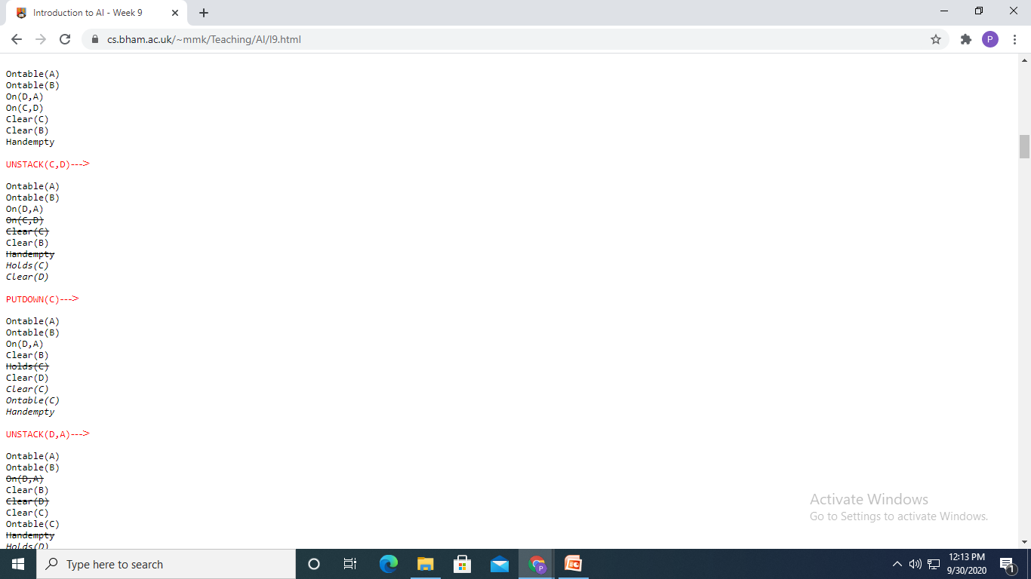
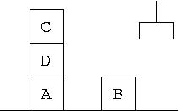
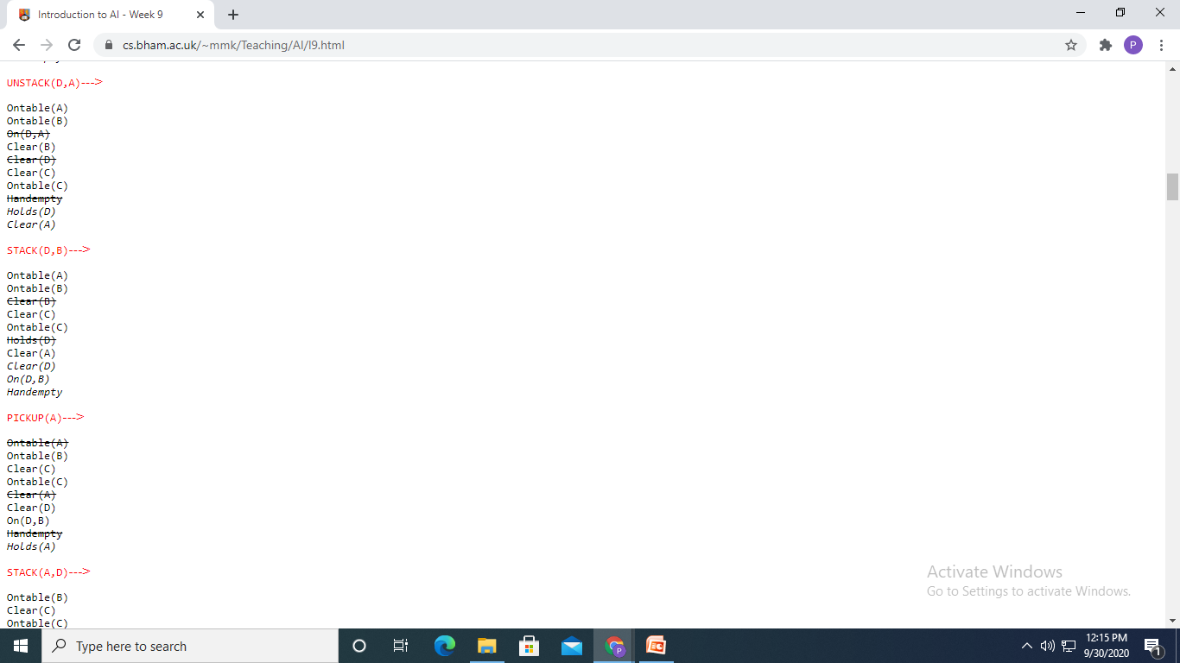
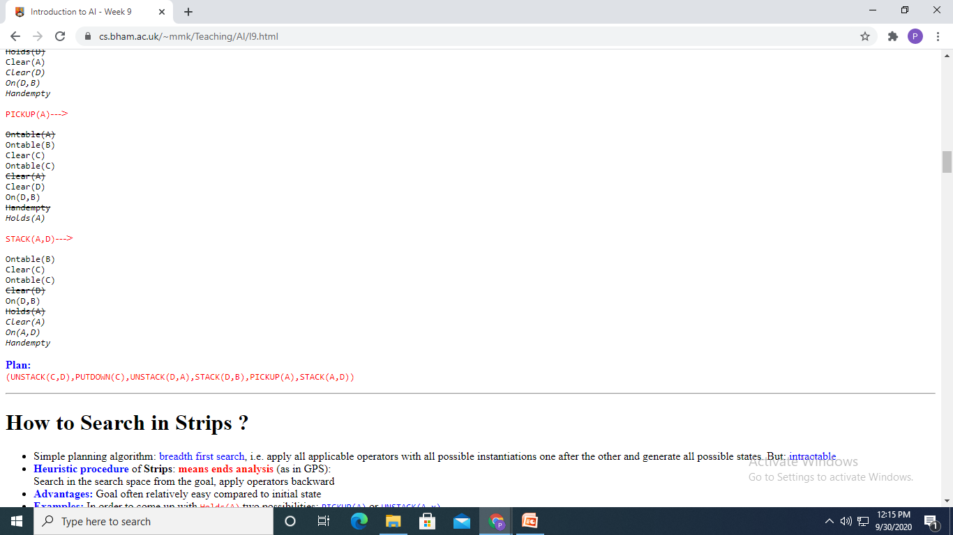
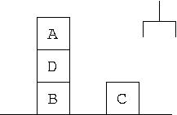
v
GOAL STACK PROBLEM- Complete solution
(UNSTACK(C,D),PUTDOWN(C),UNSTACK(D,A),STACK(D,B),PICKUP(A),STACK(A,D))

Slide 23
Example
GOAL STACK PROBLEM-
The Working!
Initial state
Goal state
A
C
C
A
B
B
1. Place on stack original
goal:
Stack:
On(A,C) & On(C,B)
Database:
CLEAR(B)
ON(C,A)
CLEAR(C)
ONTABLE(A)
ONTABLE(B)
HANDEMPTY

Slide 24
GOAL STACK PROBLEM-
The Working!
2. Since top goal is unsatisfied compound goal, list its unsatisfied subgoals on top of it:
On(C,B)
Stack:
On(A,C)
On(A,C) & On(C,B)
CLEAR(B)
ON(C,A)
CLEAR(C)
ONTABLE(A)
ONTABLE(B)
HANDEMPTY
Database
(unchanged):

Slide 25
GOAL STACK PROBLEM-
The Working!
3. Since top goal is unsatisfied single-literal goal, find rule whose instantiated add-list includes the goal, and: a. Replace the goal with the instantiated rule; b. Place the rule’s instantiated precondition formula on top of stack
Holding(C) & Clear(B)
Stack:
stack(C,B)
On(C,B)
On(A,C)
On(A,C) & On(C,B)
CLEAR(B)
ON(C,A)
CLEAR(C)
ONTABLE(A)
ONTABLE(B)
HANDEMPTY
Database
(unchanged):

Slide 26
GOAL STACK PROBLEM-
The Working!
4. Since top goal is unsatisfied compound goal, list its subgoals on top of it:
Clear(B)
Holding(C)
Stack:
Holding(C) & Clear(B)
stack(C,B)
On(A,C)
On(A,C) & On(C,B)
CLEAR(B)
ON(C,A)
CLEAR(C)
ONTABLE(A)
ONTABLE(B)
HANDEMPTY
Database
(unchanged):

Slide 27
GOAL STACK PROBLEM-
The Working!
5. Single goal on top of stack matches data base, so remove it:
Clear(B)
Holding(C)
Stack:
Holding(C) & Clear(B)
stack(C,B)
On(A,C)
On(A,C) & On(C,B)
CLEAR(B)
ON(C,A)
CLEAR(C)
ONTABLE(A)
ONTABLE(B)
HANDEMPTY
Database
(unchanged):

Slide 28
GOAL STACK PROBLEM-
The Working!
6. Since top goal is unsatisfied single-literal goal, find rule whose instantiated add-list includes the goal, and: a. Replace the goal with the instantiated rule; b. Place the rule’s instantiated precondition formula on top of stack
On(C,A) &Clear(C) & Handempty
unstack(C,A)
Holding(C)
Holding(C) & Clear(B)
stack(C,B)
Stack:
On(A,C)
On(A,C) &On(C,B)
Database: (unchanged)

Slide 29
GOAL STACK PROBLEM-
The Working!
7. Compound goal on top of stack matches data base, so remove it:
On(C,A) &Clear(C) & Handempty
unstack(C,A)
Stack:
Holding(C) & Clear(B)
stack(C,B)
On(A,C)
On(A,C) &On(C,B)
CLEAR(B)
ON(C,A)
CLEAR(C)
ONTABLE(A)
ONTABLE(B)
HANDEMPTY
Database
(unchanged):
STEPS CONTINUES UNTIL STACK IS EMPTY!

Slide 30
Means - Ends Analysis
Search strategies either reason forward of backward
Mixed strategy - solve the major parts of problem first and solve the smaller problems the arise when combining them together.
Such a technique is called "Means - Ends Analysis".
The means -ends analysis process centers around finding the difference between current state and goal state.
The problem space of means - ends analysis has
an initial state and one or more goal state,
a set of operate with a set of preconditions their application and
difference functions computes the difference between two state a(i) and s(j).

Slide 31
Problem Solving using Means - Ends Analysis
The algorithm for MEA consists of the following steps:
Step 1: Measure the current state of things by doing as is the study and capture the status at a macro level and to a possible micro level.
Step 2: Capture the deficiency in the current state and avenues for improvements (wish list) and define the goal state (to-be state). Define the to-be state at a macro level and to a possible micro level.
Step 3: Compare the Current state and Goal state and if they are at the same level the problem is resolved.
Step 4: List the differences between the current state and goal state at macro and micro levels.
Step 5: Convert the differences into deletions/modifications to current state and new additions.
Step 6: Define the action to implement the changes as defined in step-5.
Step 7: Implement the changes and measure the actual results with the planned goals.
Step 8: Do course correction and achieve the final goal.

Slide 32
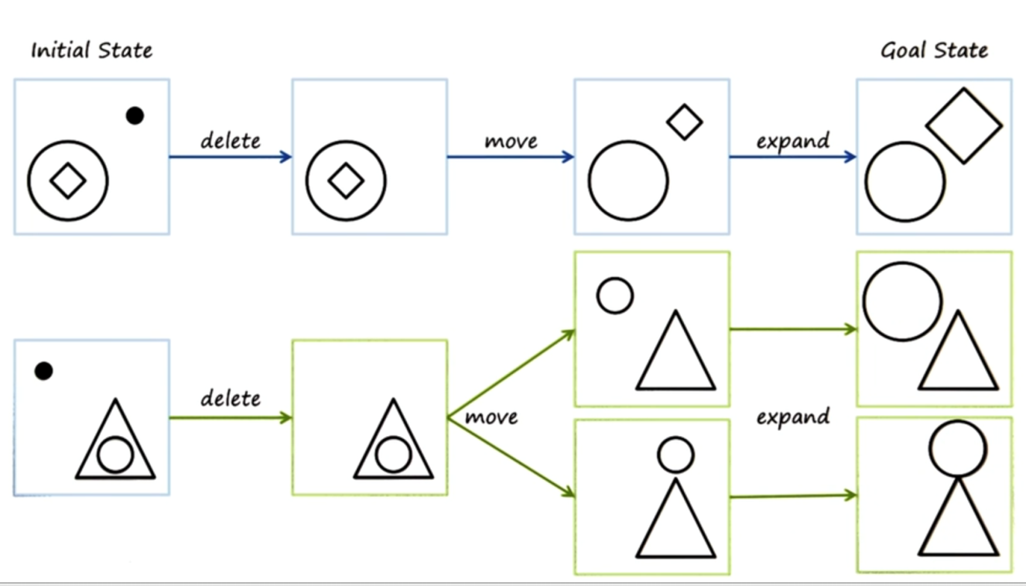
Problem Solving using Means - Ends Analysis - Example
Example 1:
If in your current state you are hungry, and in your goal state you are not hungry
Preconditions of visit_cafeteria: you know where the cafeteria is. Postconditions of visit_cafeteria: you are no longer hungry.
Example 2:

Slide 33
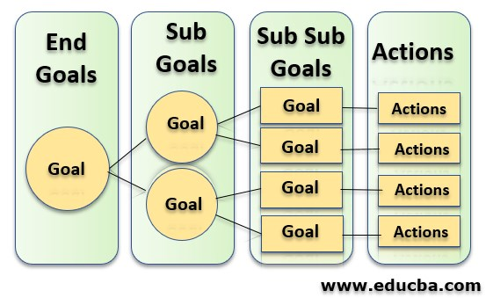
MEA – To do Exercise!
Example:
An electronics business company aims to get a turnover of Rs. 10 crores per annum. How do you do?

Slide 34
Planning and Learning Table of Contents
Planning- Planning problems, Simple planning agent, Planning languages
Blocks world ,Goal stack planning, Mean Ends Analysis
Non-linear Planning, Conditional planning, Reactive planning
Learning- Machine learning, Goals and Challenges of machine learning
Learning concepts, models, Artificial neural network based learning- Back propagation, Support vector machines,
Reinforcement learning, Adaptive learning, Multi_agent based learning, Ensemble learning, Learning for decision making, Distributed learning, Speedup learning

Slide 35
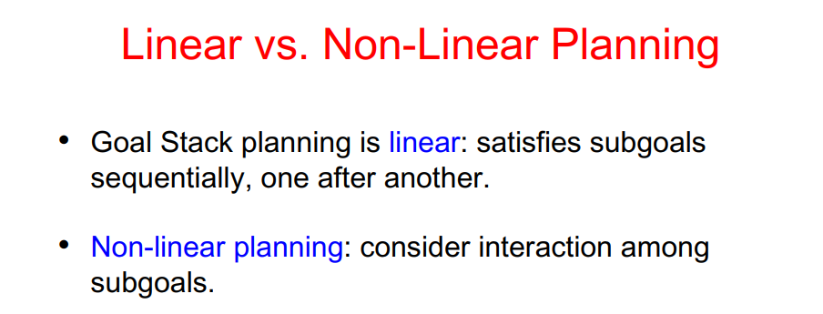
Planning and Learning

Slide 36
Partial-order planning
A linear planner builds a plan as a totally ordered sequence of plan steps
A non-linear planner (aka partial-order planner) builds up a plan as a set of steps with some temporal constraints
constraints of the form S1 < S2 if step S1 must comes before S2.
One refines a partially ordered plan (POP) by either:
adding a new plan step , or
adding a new constraint to the steps already in the plan.
A POP can be linearized (converted to a totally ordered plan) by topological sorting

Slide 37
Least commitment
Non-linear planners embody the principle of least commitment
- only choose actions, orderings, and variable bindings that are absolutely necessary, leaving other decisions till later
- avoids early commitment to decisions that don’t really matter
A linear planner always chooses to add a plan step in a particular place in the sequence
A non-linear planner chooses to add a step and possibly some temporal constraints

Slide 38
Non-linear plan
A non-linear plan consists of
A set of steps {S₁, S₂, S₃, S₄ …}
Each step has an operator description, preconditions and post-conditions
(2) A set of causal links { … (S_{i,} C, S_{j}) …}
Meaning a purpose of step S_{i} is to achieve precondition C of step S_{j}
(3) A set of ordering constraints { … S_{i} < S_{j} … }
if step S_{i} must come before step S_{j}
A non-linear plan is complete iff
- Every step mentioned in (2) and (3) is in (1)
- If S_{j} has prerequisite C, then there exists a causal link in (2) of the form (S_{i,} C, S_{j}) for some S_{i}
- If (S_{i,} C, S_{j} ) is in (2) and step S_{k} is in (1), and S_{k} threatens (S_{i,} C, S_{j}) (makes C false), then (3) contains either S_{k} < S_{i} or S_{k} > S_{j}

Slide 39
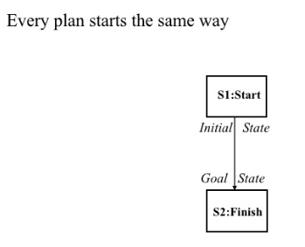
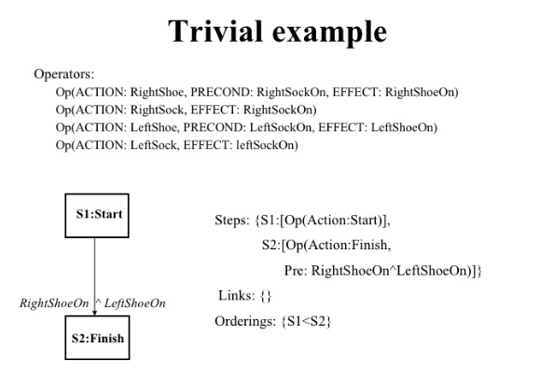
The initial plan

Slide 40
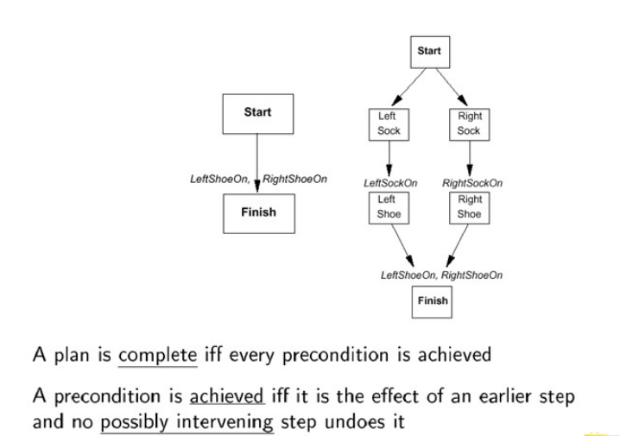
Solution

Slide 41
Conditional Planning
The agent might not know what the initial state is
The agent might not know the outcome of its actions
The plans will have branches rather than being straight line plans, includes conditional steps
if < test > then plan A else plan B
Full observability: The agent knows what state it currently is, does not have to execute an observation action Simply get plans ready for all possible contingencies
Actions sometimes fail → disjunctive effects
Example: moving left sometimes fails
Action (Left, PRECOND: AtR, EFFECT: AtL ∨ AtR )

Slide 42
Conditional Planning
Conditional effects: effects are conditioned on secondary preconditions
Action (Suck, PRECOND: ;,
EFFECT: (when AtL: CleanL ) ∧ (when AtR: CleanR))
Actions may have both disjunctive and conditional effects: Moving sometimes dumps dirt on the destination square only when that square is clean
Action (Left, PRECOND: AtR;, EFFECT: AtL ∨ (AtL ∧ when CleanL: ¬ CleanL))
Example : The vacuum world

Slide 43
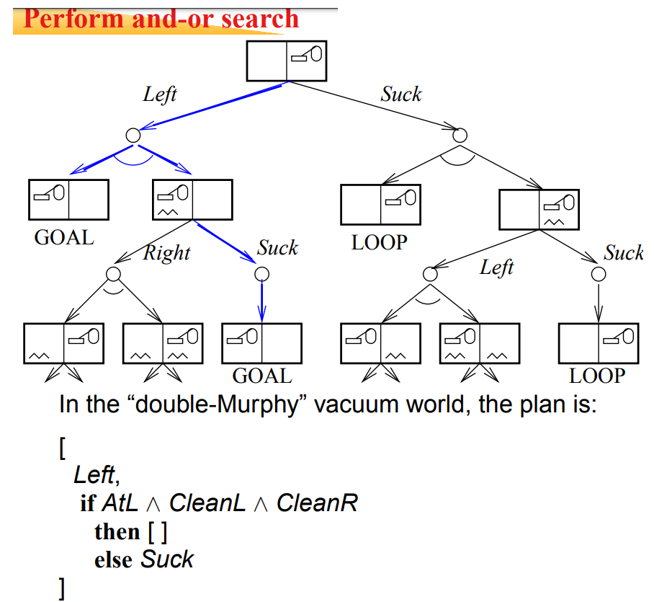
Conditional Planning

Slide 44
Partially observable environments
The agent knows only a certain amount of the actual state (e.g., local sensing only, does not know about the other squares)
Automatic sensing: at every time step the agent gets all the available percepts
Active sensing: percepts are obtained only by executing specific sensory actions
Belief state: The set of possible states that the agent can be in
“Alternate double Murphy world”: dirt can sometimes be left behind when the agent leaves a clean square

Slide 45
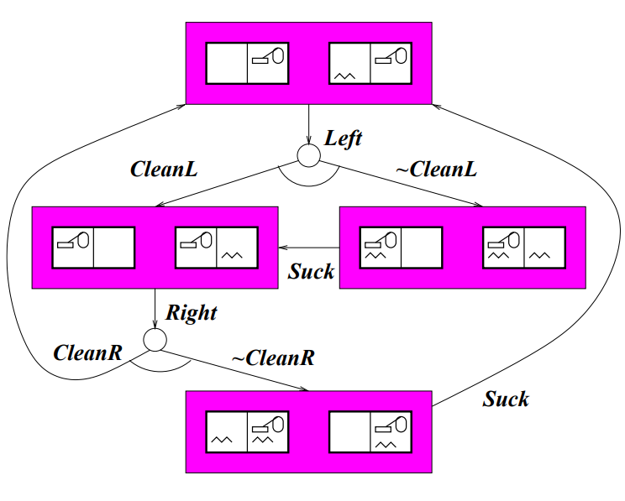
Example –Part of the Search

Slide 46
Reactive planning
Reactive planning is planning under uncertainty.
A group of techniques for action selection by autonomous agents.
Diﬀers from classical planning in two aspects:
➤ operate in a timely fashion and hence can cope with highly dynamic and unpredictable environments.
➤ compute just one next action in every instant, based on the current context.
Reactive planners often (but not always) exploit reactive plans, which are stored structures describing the agent's priorities and behaviour.
Makes use of the if-then rules.
The rule which is at present in execution is said to be active whereas the others are inactive.

Slide 47
REACTIVE PLAN REPRESENTATION
➤ Finite State Machines (FSMs) and Behavior trees
➤ Fuzzy approaches (Utility Systems)
➤ Connectionists approaches

Slide 48
Planning and Learning Table of Contents
Planning- Planning problems, Simple planning agent, Planning languages
Blocks world ,Goal stack planning, Mean Ends Analysis
Non-linear Planning, Conditional planning, Reactive planning
Learning- Machine learning, Goals and Challenges of machine learning
Learning concepts, models, Artificial neural network based learning- Back propagation, Support vector machines
Reinforcement learning, Adaptive learning, Multi_agent based learning, Ensemble learning, Learning for decision making, Distributed learning, Speedup learning

Slide 49
Learning
An agent is learning if it improves its performance on future tasks after making observations about the world.
Any component of an agent can be improved by learning from data.
The improvements, and the techniques used to make them, depend on four major factors:
• Which component is to be improved.
What prior knowledge the agent already has.
• What representation is used for the data and the component.
• What feedback is available to learn from.

Slide 50
Machine Learning Defined
The oft quoted and widely accepted formal definition of machine learning as stated by field pioneer Tom M. Mitchell is:
A computer program is said to learn from experience E with respect to some class of tasks T and performance measure P if its performance at tasks in T, as measured by P, improves with experience E
Another Definition of Machine learning :
Machine learning is a subfield of computer science, but is often also referred to as predictive analytics, or predictive modeling. Its goal and usage is to build new and/or leverage existing algorithms to learn from data, in order to build generalizable models that give accurate predictions, or to find patterns, particularly with new and unseen similar data.

Slide 51
Goals of Machine Learning
The goal of ML, in simples words, is to understand the nature of (human and other forms of) learning, and to build learning capability in computers.
To be more specific, there are three aspects of the goals of ML.
To make the computers smarter, more intelligent. The more direct objective in this aspect is to develop systems (programs) for specific practical learning tasks in application domains.
To develop computational models of human learning process and perform computer simulations. The study in this aspect is also called cognitive modeling.
To explore new learning methods and develop general learning algorithms independent of applications.

Slide 52
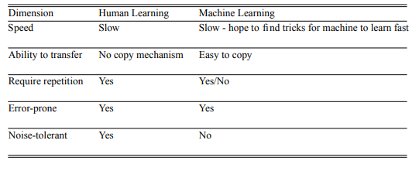
Challenges of Machine Learning
In Machine Learning, we can hope to discover ways for machine to learn which are better than ways human learn (the opportunity), and that there are amply amount of difficulties to be overcome in order to make machines learn (the challenge).

Slide 53
Planning and Learning Table of Contents
Planning- Planning problems, Simple planning agent, Planning languages
Blocks world ,Goal stack planning, Mean Ends Analysis
Non-linear Planning, Conditional planning, Reactive planning
Learning- Machine learning, Goals and Challenges of machine learning
Learning concepts, models, Artificial neural network based learning- Back propagation, Support vector machines
Reinforcement learning, Adaptive learning, Multi_agent based learning, Ensemble learning, Learning for decision making, Distributed learning, Speedup learning

Slide 54
Learning concepts
Supervised Learning - Involves learning a function that maps an input to an output based on example input-output pairs
Unsupervised Learning - The machine learns from data for which the outcomes are not known. It’s given input samples, but no output samples
Semi-Supervised Learning -A model uses unlabeled data to gain a general sense of the data’s structure, then uses a small amount of labeled data to learn how to group and organize the data as a whole. Sometimes referred to as “weak learning.”
Reinforcement Learning – Allows the machine or agent to learn its behaviour based on feedback from the environment

Slide 55



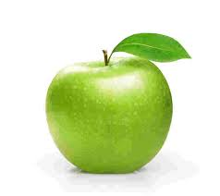
Supervised Learning
If shape of object is rounded and depression at top having color Red then it will be labelled as –Apple.
If shape of object is rounded and depression at top having color Green then it will be labelled as –Green Apple.
If shape of object is long curving cylinder having color Green-Yellow then it will be labelled as –Banana.

Slide 56
Supervised Learning Contd…
Supervised learning
Regression
A classification problem is when the output variable is a category, such as “Red” or “blue” or “disease” and “no disease”.
A regression problem is when the output variable is a real value, such as “dollars” or “weight”.
Classification

Slide 57
CLASSIFICATION
Which of the following are classification tasks?
Find the gender of a person by analyzing his writing style
Predict the price of a house based on floor area, number of rooms etc.
Predict whether there will be abnormally heavy rainfall next year
Predict the number of copies of a book that will be sold this month

Slide 58
CLASSIFICATION
Which of the following are classification tasks?
Find the gender of a person by analyzing his writing style
Predict the price of a house based on floor area, number of rooms etc.
Predict whether there will be abnormally heavy rainfall next year
Predict the number of copies of a book that will be sold this month

Slide 59
REGRESSION
Which ONE of the following are regression tasks?
Predict the age of a person
Predict the country from where the person comes from
Predict whether the price of petroleum will increase tomorrow
Predict whether a document is related to science

Slide 60
REGRESSION
Which ONE of the following are regression tasks?
Predict the age of a person
Predict the country from where the person comes from
Predict whether the price of petroleum will increase tomorrow
Predict whether a document is related to science

Slide 61





Un-Supervised Learning

Slide 62
Un -Supervised Learning
Which of the following are examples of unsupervised learning?
Group news articles based on text similarity
Make clusters of books on similar topics in a library
Filter out spam emails
Segment online customers into two classes based on their age group – below 25 or above 25

Slide 63
Un -Supervised Learning
Which of the following are examples of unsupervised learning?
Group news articles based on text similarity
Make clusters of books on similar topics in a library
Filter out spam emails
Segment online customers into two classes based on their age group – below 25 or above 25

Slide 64
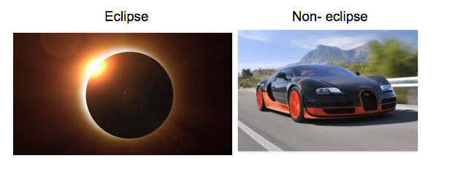
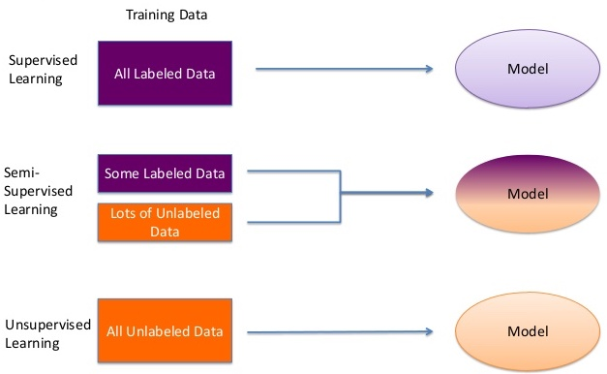
Semi Supervised Learning

Slide 65

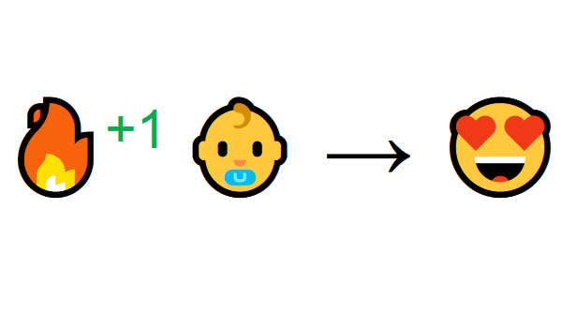
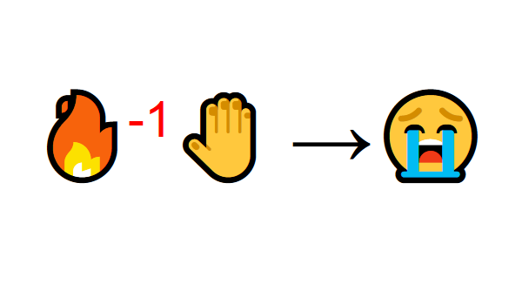
Reinforcement Learning
The idea behind Reinforcement Learning is that an agent will learn from the environment by interacting with it and receiving rewards for performing actions.
That’s how humans learn, through interaction. Reinforcement Learning is just a computational approach of learning from action.

Slide 66
CATEGORICAL VS CONTINOUS
CATEGORICAL:
CONTINOUS:
Age, height, weight, price
Finite number of categories of classes
Gender, age group, Presence or absence of something
Infinite number of values

Slide 67
Introduction to simple linear regression
Relation between variables where changes in some variables may “explain” or possibly “cause” changes in other variables.
Explanatory variables are termed the independent variables and the variables to be explained are termed the dependent variables.
Regression model estimates the nature of the relationship between the independent and dependent variables.
Change in dependent variables that results from changes in independent variables, ie. size of the relationship.
Strength of the relationship.
Statistical significance of the relationship.

Slide 68
Examples
Dependent variables
Retail price of petrol in Chennai
Independent variables
The price of crude oil.
Employment income
Hours of work, education, occupation, sex, age, region, years of experience, unionization status, etc
Quantity of product sold
Price

Slide 69
Bivariate and multivariate models
Bivariate or simple regression model
(Education) x y (Income)
(Education) x₁
(Gender) x₂
(Experience) x₃
(Age) x₄
y (Income)
y (Income)
Model with simultaneous relationship
Price of wheat
Quantity of wheat produced

Slide 70
Bivariate or simple linear regression
x is the independent variable
y is the dependent variable
The regression model is
The model has two variables, the independent or explanatory variable, x, and the dependent variable y, the variable whose variation is to be explained.
The relationship between x and y is a linear or straight line relationship.
Two parameters to estimate – the slope of the line β₁ and the y-intercept β₀ (where the line crosses the vertical axis).
ε is the unexplained, random, or error component. Much more on this later.

Slide 71
Regression line
The regression model is
Data about x and y are obtained from a sample.
From the sample of values of x and y, estimates b₀ of β₀ and b₁ of β₁ are obtained using the least squares or another method.
The resulting estimate of the model is
The symbol is termed “y hat” and refers to the predicted values of the dependent variable y that are associated with values of x, given the linear model.

Slide 72
Uses of regression
Amount of change in a dependent variable that results from changes in the independent variable(s) – can be used to estimate elasticities, returns on investment in human capital, etc.
Attempt to determine causes of phenomena.
Prediction and forecasting of sales, economic growth, etc.
Support or negate theoretical model.
Modify and improve theoretical models and explanations of phenomena.

Slide 73
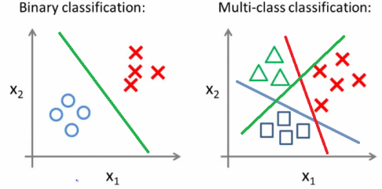
Classification Techniques
What is Classification?
It is a process of categorizing a given set of feature vectors into two or more classes.
Classification Techniques:
Logistic Regression
Artificial Neural Networks (ANN)
Support Vector Machine (SVM)
Deep Neural Network (DNN)
Convolution Neural Network (1D-CNN and 2D-CNN)

Slide 74

Logistic Regression
Logistic Regression is a Machine Learning classification algorithm that is used to predict the probability of a categorical dependent variable.
In logistic regression, the dependent variable is a binary variable that contains data coded as 1 (yes, success, etc.) or 0 (no, failure, etc.). In other words, the logistic regression model predicts P(Y=1) as a function of X.

Slide 75
Types of Logistic Regression
1. Binary Logistic Regression: The categorical response has only two 2 possible outcomes. E.g.: Spam or Not
2. Multinomial Logistic Regression: Three or more categories without ordering. E.g.: Predicting which food is preferred more (Veg, Non-Veg, Vegan)
3. Ordinal Logistic Regression: Three or more categories with ordering. E.g.: Movie rating from 1 to 5

Slide 76
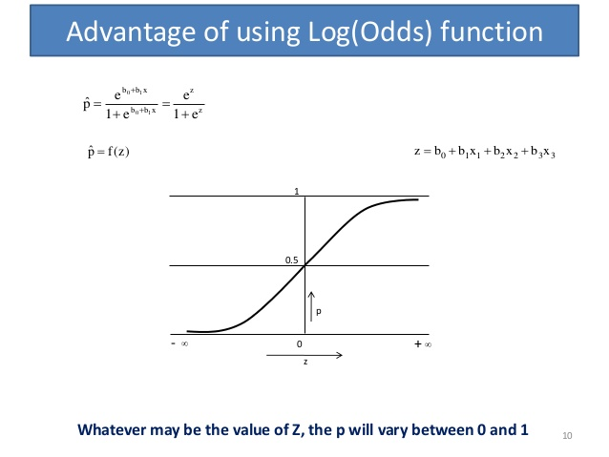
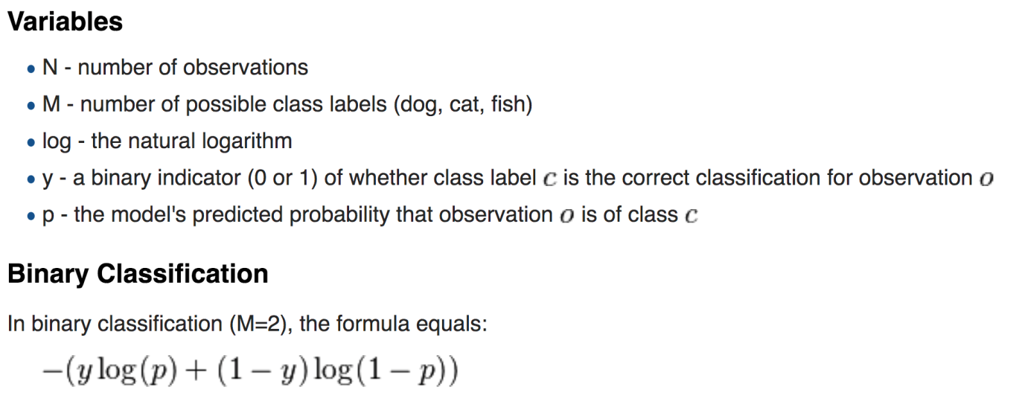
Math behind Binary Logistic Regression
Demo

Slide 77
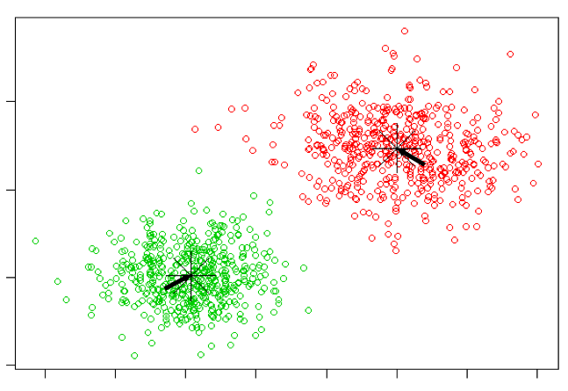
Clustering Techniques
What is Clustering?
It is a process of dividing the given set of feature vectors into two or more groups (clusters). The data points in each cluster are somehow related to each other.
Applications of Clustering
Recommendation engines
Market segmentation
Social network analysis
Search result grouping
Image segmentation
Clustering Techniques:
k-means Clustering
Hierarchical Clustering

Slide 78
K-means Clustering Algorithm
Start
Initialize k centroids (k mean vectors)
Yes
Compute distance between each feature vector to all the centroids
Is there any change in Centroid?
No
Assign each feature vector to any one of the Centroid based on minimum Euclidean distance
End
Re-estimate the Centroids

Slide 79
K-means Clustering Algorithm
K-Means clustering is an unsupervised iterative clustering technique.
It partitions the given data set into k predefined distinct clusters.
A cluster is defined as a collection of data points exhibiting certain similarities.

Slide 80
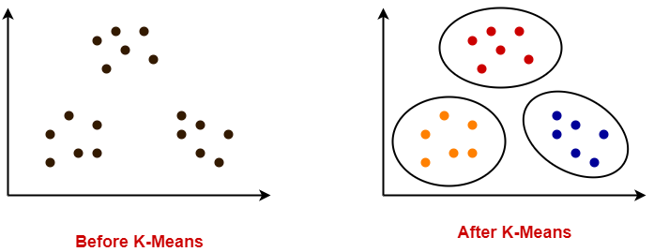
K-means Clustering Algorithm
It partitions the data set such that-
Each data point belongs to a cluster with the nearest mean.
Data points belonging to one cluster have high degree of similarity.
Data points belonging to different clusters have high degree of dissimilarity.

Slide 81
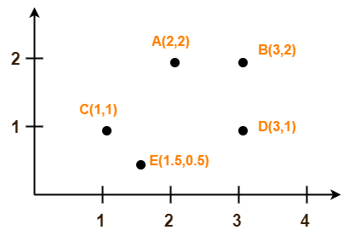
Use K-Means Algorithm to create two clusters
C1
A | 2 | 2 |  | C1 | 1.5 | 1.166667
C1 | 1 | 1
E | 1.5 | 0.5
C2
B | 3 | 2 |  | C2 | 3 | 1.5
D | 3 | 1
Demo

Slide 82
Models
Artificial neural networks
Decision trees
Support-vector machines
Regression analysis
Bayesian networks
Genetic algorithms

Slide 83
Artificial neural network based learning
Artificial Neural Network ANN is an efficient computing system whose central theme is borrowed from the analogy of biological neural networks.
ANNs are also named as “artificial neural systems” acquires a large collection of units that are interconnected in some pattern to allow communication between the units. These units, also referred to as nodes or neurons, are simple processors which operate in parallel.
Every neuron is connected with other neuron through a connection link. Each connection link is associated with a weight that has information about the input signal. This is the most useful information for neurons to solve a particular problem because the weight usually excites or inhibits the signal that is being communicated.
Each neuron has an internal state, which is called an activation signal. Output signals, which are produced after combining the input signals and activation rule, may be sent to other units.

Slide 84
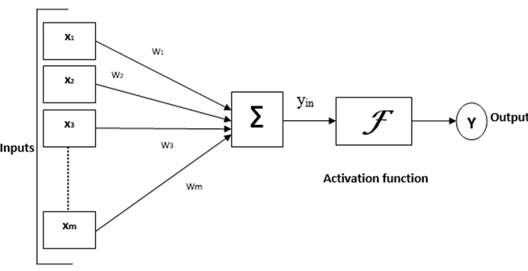
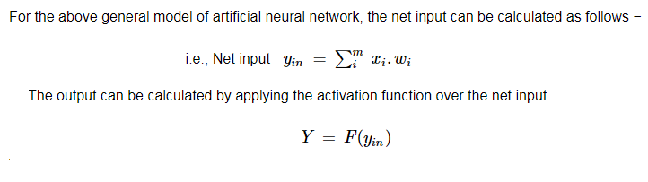
Model of Artificial Neural Network

Slide 85
Back Propagation Method
Back propagation is a common method for training a neural network.
It is the method of fine-tuning the weights of a neural net based on the error rate obtained in the previous epoch (i.e., iteration).
Proper tuning of the weights allows you to reduce error rates and to make the model reliable by increasing its generalization
TWO STEPS:
Forward pass phase: computes ‘functional signal’, feed forward propagation of input pattern signals through network
Backward pass phase: computes ‘error signal’, propagates the error backwards through network starting at output units (where the error is the difference between actual and desired output values

Slide 86
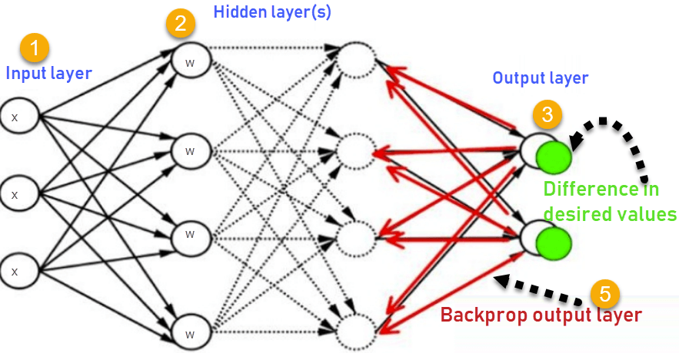
Back Propagation Algorithm

Slide 87
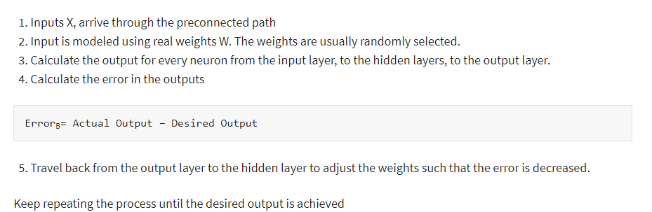
Back Propagation Algorithm

Slide 88
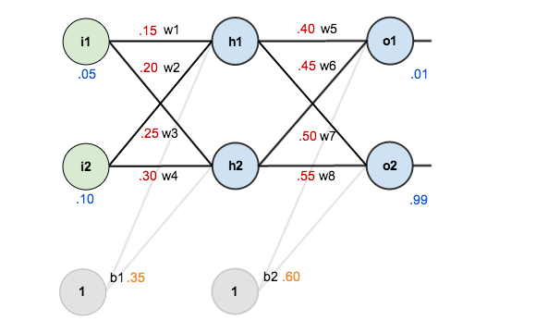
Back Propagation Algorithm
A neural network with two inputs, two hidden neurons, two output neurons. Additionally, the hidden and output neurons will include a bias.
The initial weights, the biases, and training inputs/outputs are given as follows:
The goal of back propagation is to optimize the weights so that the neural network can learn how to correctly map arbitrary inputs to outputs.
we’re going to work with a single training set:
given inputs 0.05 and 0.10,
we want the neural network to output 0.01 and 0.99.(Expected / Desired)

Slide 89
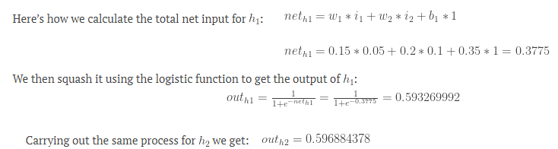
The Forward Pass
First, we’ll feed the inputs 0.05 and 0.10 forward through the network.
We figure out the total net input to each hidden layer neuron, squash the total net input using an activation function (here we use the logistic function), then repeat the process with the output layer neurons.

Slide 90
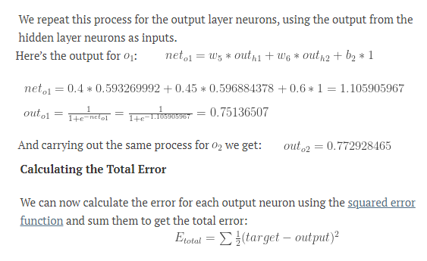
The Forward Pass contd…

Slide 91
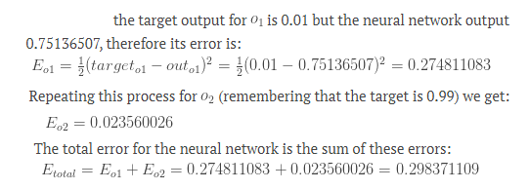
The Forward Pass contd…

Slide 92
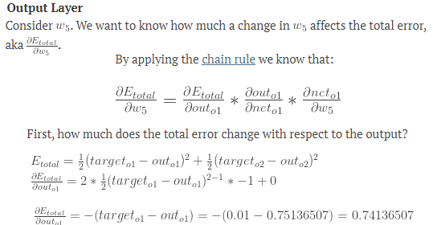
The Backward Pass
Our goal with back propagation is to update each of the weights in the network so that they cause the actual output to be closer the target output, thereby minimizing the error for each output neuron and the network as a whole.

Slide 93
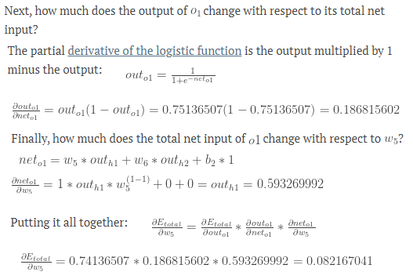
The Backward Pass contd…

Slide 94
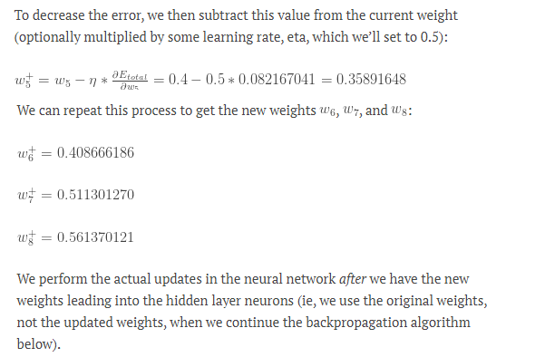
The Backward Pass contd…

Slide 95
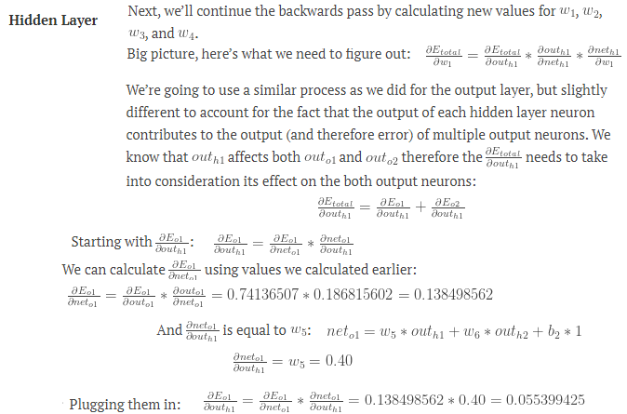
The Backward Pass contd…

Slide 96
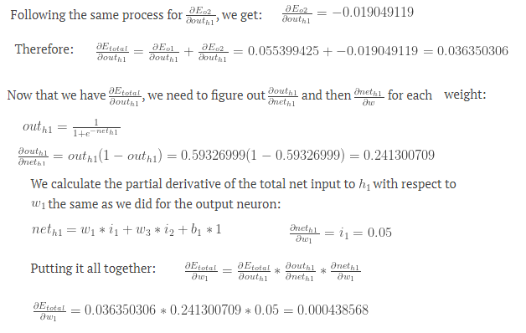
The Backward Pass contd…

Slide 97
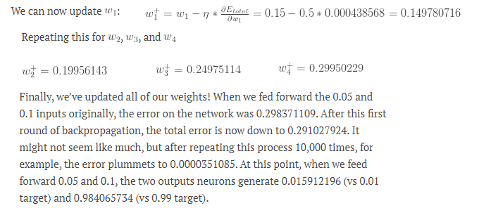
The Backward Pass contd…

Slide 98
Planning and Learning Table of Contents
Planning- Planning problems, Simple planning agent, Planning languages
Blocks world ,Goal stack planning, Mean Ends Analysis
Non-linear Planning, Conditional planning, Reactive planning
Learning- Machine learning, Goals and Challenges of machine learning
Learning concepts, models, Artificial neural network based learning- Back propagation, Support vector machines
Reinforcement learning, Adaptive learning, Multi_agent based learning, Ensemble learning, Learning for decision making, Distributed learning, Speedup learning

Slide 99
Support vector machines
Support Vector Machines is considered to be a classification approach, it but can be employed in both types of classification and regression problems.
It can easily handle multiple continuous and categorical variables.
SVM constructs a hyperplane in multidimensional space to separate different classes.
SVM generates optimal hyperplane in an iterative manner, which is used to minimize an error.
The core idea of SVM is to find a maximum marginal hyperplane(MMH) that best divides the dataset into classes.

Slide 100
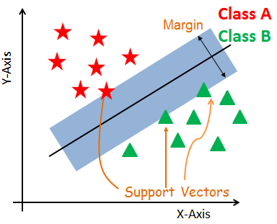
Support vector machines
Support Vectors - The data points, which are closest to the hyperplane. These points will define the separating line better by calculating margins.
These points are more relevant to the construction of the classifier
Hyperplane - A decision plane which separates between a set of objects having different class memberships.
Margin - A margin is a gap between the two lines on the closest class points. This is calculated as the perpendicular distance from the line to support vectors or closest points. If the margin is larger in between the classes, then it is considered a good margin, a smaller margin is a bad margin.

Slide 101
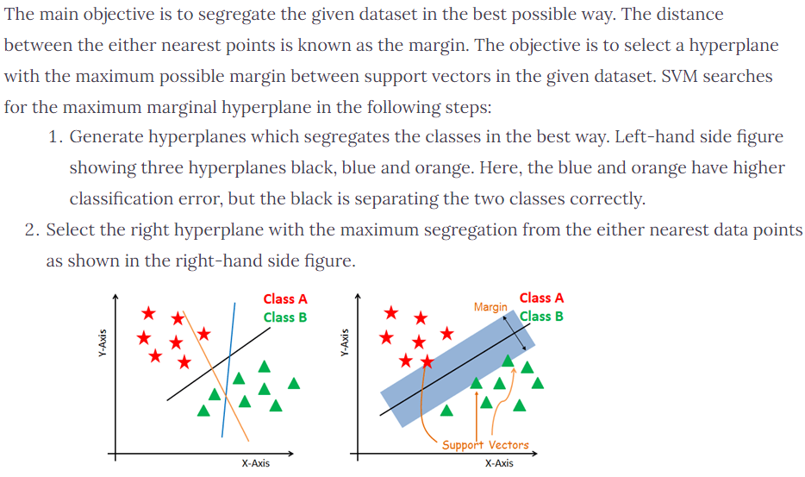
How does SVM work?

Slide 102
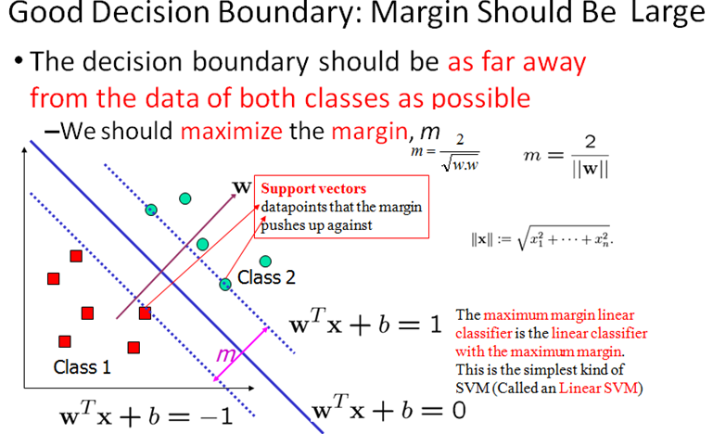
How does SVM work?

Slide 103
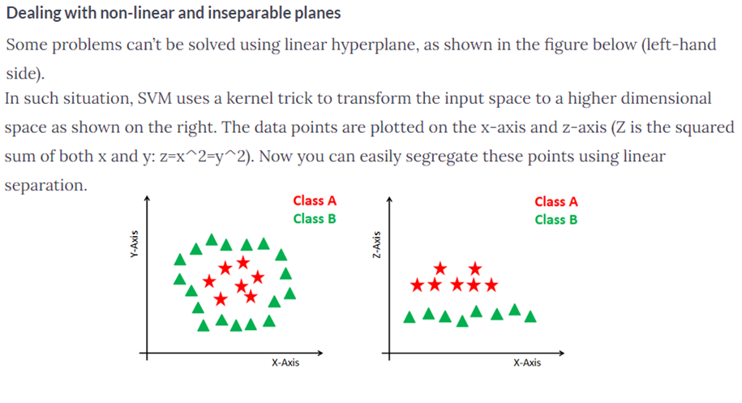
How does SVM work?

Slide 104
SVM Kernels
The SVM algorithm is implemented in practice using a kernel. A kernel transforms an input data space into the required form. SVM uses a technique called the kernel trick. Here, the kernel takes a low-dimensional input space and transforms it into a higher dimensional space.(it converts non separable problem to separable problems by adding more dimension to it) It is most useful in non-linear separation problem. Kernel trick helps us to build a more accurate classifier.
TYPES:
Linear Kernel : A linear kernel can be used as normal dot product any two given observations. The product between two vectors is the sum of the multiplication of each pair of input values. K(x, xi) = sum(x * xi)
Polynomial Kernel A polynomial kernel is a more generalized form of the linear kernel. The polynomial kernel can distinguish curved or nonlinear input space.
K(x,xi) = 1 + sum(x * xi)^d
Where d is the degree of the polynomial. d=1 is similar to the linear transformation. The degree needs to be manually specified in the learning algorithm.

Slide 105
SVM Kernels
Radial Basis Function Kernel The Radial basis function kernel is a popular kernel function commonly used in support vector machine classification. RBF can map an input space in infinite dimensional space.
K(x,xi) = exp(-gamma * sum((x – xi^2))

Slide 106
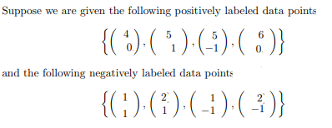

SVM -Linear Example

Slide 107

SVM -Linear Example

Slide 108

SVM -Linear Example

Slide 109

SVM -Linear Example

Slide 110

SVM -Linear Example

Slide 111

SVM -Linear Example

Slide 112

SVM -Linear Example

Slide 113

SVM -Linear Example

Slide 114
Planning and Learning Table of Contents
Planning- Planning problems, Simple planning agent, Planning languages
Blocks world ,Goal stack planning, Mean Ends Analysis
Non-linear Planning, Conditional planning, Reactive planning
Learning- Machine learning, Goals and Challenges of machine learning
Learning concepts, models, Artificial neural network based learning- Back propagation, Support vector machines,
Reinforcement learning, Adaptive learning, Multi_agent based learning, Ensemble learning, Learning for decision making, Distributed learning, Speedup learning

Slide 115
Reinforcement Learning
Reinforcement Learning is a feedback-based Machine learning technique in which an agent learns to behave in an environment by performing the actions and seeing the results of actions. For each good action, the agent gets positive feedback, and for each bad action, the agent gets negative feedback or penalty.
In Reinforcement Learning, the agent learns automatically using feedbacks without any labeled data, unlike supervised learning.
Since there is no labeled data, so the agent is bound to learn by its experience only.
RL solves a specific type of problem where decision making is sequential, and the goal is long-term, such as game-playing, robotics, etc.
The agent interacts with the environment and explores it by itself. The primary goal of an agent in reinforcement learning is to improve the performance by getting the maximum positive rewards.

Slide 116
Approaches to implement Reinforcement Learning
There are mainly three ways to implement reinforcement-learning in ML, which are:
Value-based: The value-based approach is about to find the optimal value function, which is the maximum value at a state under any policy. Therefore, the agent expects the long-term return at any state(s) under policy π.
Policy-based: Policy-based approach is to find the optimal policy for the maximum future rewards without using the value function. In this approach, the agent tries to apply such a policy that the action performed in each step helps to maximize the future reward. The policy-based approach has mainly two types of policy:
Deterministic: The same action is produced by the policy (π) at any state.
Stochastic: In this policy, probability determines the produced action.
Model-based: In the model-based approach, a virtual model is created for the environment, and the agent explores that environment to learn it. There is no particular solution or algorithm for this approach because the model representation is different for each environment.

Slide 117

Reinforcement Learning Example

Slide 118

Reinforcement Learning Example

Slide 119

Reinforcement Learning Example

Slide 120

Reinforcement Learning Example

Slide 121

Reinforcement Learning Example
Introducing the Q-Table
Q-Table is just a fancy name for a simple lookup table where we calculate the maximum expected future rewards for action at each state. Basically, this table will guide us to the best action at each state.

Slide 122

Reinforcement Learning Example

Slide 123

Reinforcement Learning Example

Slide 124

Reinforcement Learning Example

Slide 125

Reinforcement Learning Example

Slide 126

Reinforcement Learning Example

Slide 127

Reinforcement Learning Example

Slide 128

Reinforcement Learning Example

Slide 129

Reinforcement Learning Example

Slide 130

Elements of Reinforcement Learning

Slide 131
Types of Reinforcement learning
There are mainly two types of reinforcement learning, which are:
Positive Reinforcement
Negative Reinforcement

Slide 132
Positive Reinforcement
The positive reinforcement learning means adding something to increase the tendency that expected behavior would occur again. It impacts positively on the behavior of the agent and increases the strength of the behavior.
This type of reinforcement can sustain the changes for a long time, but too much positive reinforcement may lead to an overload of states that can reduce the consequences.

Slide 133
Negative Reinforcement
The negative reinforcement learning is opposite to the positive reinforcement as it increases the tendency that the specific behavior will occur again by avoiding the negative condition.
It can be more effective than the positive reinforcement depending on situation and behavior, but it provides reinforcement only to meet minimum behavior.

Slide 134

Reinforcement Learning Vs Supervised Learning

Slide 135

Reinforcement Learning Applications
Applications:

Slide 136
Reinforcement Learning Challenges
Feature/reward design which should be very involved
Parameters may affect the speed of learning.
Realistic environments can have partial observability.
Too much Reinforcement may lead to an overload of states which can diminish the results.
Realistic environments can be non-stationary.

Slide 137
Planning and Learning Table of Contents
Planning- Planning problems, Simple planning agent, Planning languages
Blocks world ,Goal stack planning, Mean Ends Analysis
Non-linear Planning, Conditional planning, Reactive planning
Learning- Machine learning, Goals and Challenges of machine learning
Learning concepts, models, Artificial neural network based learning- Back propagation, Support vector machines,
Reinforcement learning, Adaptive learning, Multi_agent based learning, Ensemble learning, Learning for decision making, Distributed learning, Speedup learning

Slide 138
Reinforcement Learning
Reinforcement Learning is a feedback-based Machine learning technique in which an agent learns to behave in an environment by performing the actions and seeing the results of actions. For each good action, the agent gets positive feedback, and for each bad action, the agent gets negative feedback or penalty.
In Reinforcement Learning, the agent learns automatically using feedbacks without any labeled data, unlike supervised learning.
Since there is no labeled data, so the agent is bound to learn by its experience only.
RL solves a specific type of problem where decision making is sequential, and the goal is long-term, such as game-playing, robotics, etc.
The agent interacts with the environment and explores it by itself. The primary goal of an agent in reinforcement learning is to improve the performance by getting the maximum positive rewards.

Slide 139

Adaptive Learning
Next Generation of machine
Intelligence

Slide 140
Adaptive Learning
Adaptive learning brings human analysts into the process at every step. This is in contrast to rule-based, simple machine learning and deep learning approaches, where the humans only create rules and label data at the start of the process.
For example, if you had the sentence “We Will Help Tom Ford Escape from New York”, and your system hadn’t seen any examples of “Tom Ford” or “Ford Escape”, you will need human input to build the knowledge.
Adaptive learning systems require the least human effort because they only require human input when it matters most and continually expand their knowledge when new information is encountered. They are also the most accurate. They combine the three other types of machine intelligence, adding new types of ‘unsupervised machine learning’ and methods for optimizing the input from multiple, possibly disagreeing, humans.

Slide 141
Adaptive Learning Requirements
Adaptive real-time machine learning requires
Efficient reinforcement learning (how an algorithm should continuously interact with its environment to maximise its reward)
Online learning (dealing with continuous sequences of real-time data), and
Adaptive learning from a small sample size.
developing high level 'meta-learning' algorithms that can rapidly notice data changes based on a limited amount of data samples, and continuously adjust the rest of the learning model accordingly.

Slide 142
Planning and Learning Table of Contents
Planning- Planning problems, Simple planning agent, Planning languages
Blocks world ,Goal stack planning, Mean Ends Analysis
Non-linear Planning, Conditional planning, Reactive planning
Learning- Machine learning, Goals and Challenges of machine learning
Learning concepts, models, Artificial neural network based learning- Back propagation, Support vector machines,
Reinforcement learning, Adaptive learning, Multi_agent based learning, Ensemble learning, Learning for decision making, Distributed learning, Speedup learning

Slide 143

Multi_agent based learning

Slide 144

Multi_agent based learning

Slide 145

Multi_agent based learning

Slide 146

Multi_agent based learning Applications

Slide 147
Other Applications
A Multiagent Approach to Autonomous Intersection Management [Traffic Control]
Influence in Classification via Cooperative Game Theory [Education]
Multi-issue automated negotiation with different strategies for a car dealer business scenario [Business]

Slide 148
Planning and Learning Table of Contents
Planning- Planning problems, Simple planning agent, Planning languages
Blocks world ,Goal stack planning, Mean Ends Analysis
Non-linear Planning, Conditional planning, Reactive planning
Learning- Machine learning, Goals and Challenges of machine learning
Learning concepts, models, Artificial neural network based learning- Back propagation, Support vector machines,
Reinforcement learning, Adaptive learning, Multi_agent based learning, Ensemble learning, Learning for decision making, Distributed learning, Speedup learning

Slide 149
Ensemble Learning
Ensemble learning is an ML paradigm where numerous base models (which are often referred to as “weak learners”) are combined and trained to solve the same problem.
This method is based on the theory that by correctly combining several base models together
Together these ensemble models (aptly called “strong learners”) achieve better, more accurate results.
There are three main ensemble techniques: bagging, boosting and stacking.

Slide 150

Ensemble Learning – Base Idea

Slide 151
Ensemble Learning Techniques - Combining Weak Learners
Bagging: Bagging attempts to incorporate similar learners on small-sample populations and calculates the average of all the predictions. Generally, bagging allows you to use different learners in different populations. By doing so, this method helps to reduce the variance error.
Boosting: Boosting is an iterative method that fine-tunes the weight of an observation according to the most recent classification. If an observation was incorrectly classified, this method will increase the weight of that observation in the next round (in which the next model will be trained) and will be less prone to misclassification. Similarly, if an observation was classified correctly, then it will reduce its weight for the next classifier. The weight represents how important the correct classification of the specific data point should be, as this enables the sequential classifiers to focus on examples previously misclassified. Generally, boosting reduces the bias error and forms strong predictive models, but at times they may overfit on the training data.
Stacking: Stacking is a clever way of combining the information provided by different models. With this method, a learner of any sort can be used to combine different learners’ outputs. The result can be a decrease in bias or variance determined by which combined models are used.

Slide 152
Planning and Learning Table of Contents
Planning- Planning problems, Simple planning agent, Planning languages
Blocks world ,Goal stack planning, Mean Ends Analysis
Non-linear Planning, Conditional planning, Reactive planning
Learning- Machine learning, Goals and Challenges of machine learning
Learning concepts, models, Artificial neural network based learning- Back propagation, Support vector machines,
Reinforcement learning, Adaptive learning, Multi_agent based learning, Ensemble learning, Learning for decision making, Distributed learning, Speedup learning

Slide 153

Learning for decision making
AI systems for decision-making can be understood as lying along a spectrum according to their levels of autonomy.
In some cases, human experts use AI techniques to support them in reasoning about a single, high-stakes decision.
In other settings, it makes sense for an AI system to make autonomous decisions and
In between there are ‘mixed-initiative’ systems that share varying degrees of responsibility for action between humans and an AI systems

Slide 154

Learning and Decision-Making Model
The following figure gives the architecture of the new forecasting module.
Its applications vary from health-care decision making to hospitality industry and revenue management. This forecasting tool will lie beneath the decision system.

Slide 155

Learning and Decision-Making Model
Complete decision-system architecture for decision making based on incremental learning is depicted in figure below.
The decision manager is responsible for decision making and works on historical data and behavior mapping. Qualitative inputs and incremental quantitative inputs facilitate decision making.

Slide 156
Planning and Learning Table of Contents
Planning- Planning problems, Simple planning agent, Planning languages
Blocks world ,Goal stack planning, Mean Ends Analysis
Non-linear Planning, Conditional planning, Reactive planning
Learning- Machine learning, Goals and Challenges of machine learning
Learning concepts, models, Artificial neural network based learning- Back propagation, Support vector machines,
Reinforcement learning, Adaptive learning, Multi_agent based learning, Ensemble learning, Learning for decision making, Distributed learning, Speedup learning

Slide 157
Distributed Learning
Distributed machine learning refers to multinode machine learning algorithms and systems that are designed to improve performance, increase accuracy, and scale to larger input data sizes.
Increasing the input data size for many algorithms can significantly reduce the learning error and can often be more effective than using more complex methods
Distributed machine learning allows companies, researchers, and individuals to make informed decisions and draw meaningful conclusions from large amounts of data

Slide 158

Distributed ML Framework

Slide 159

Data parallelism

Slide 160

Model parallelism

Slide 161

Distributed ML algorithms -Challenges

Slide 162
Planning and Learning Table of Contents
Planning- Planning problems, Simple planning agent, Planning languages
Blocks world ,Goal stack planning, Mean Ends Analysis
Non-linear Planning, Conditional planning, Reactive planning
Learning- Machine learning, Goals and Challenges of machine learning
Learning concepts, models, Artificial neural network based learning- Back propagation, Support vector machines,
Reinforcement learning, Adaptive learning, Multi_agent based learning, Ensemble learning, Learning for decision making, Distributed learning, Speedup learning

Slide 163
Speedup learning
Speedup learning is a branch of machine learning that studies learning mechanisms for speeding up problem solvers based on problem solving experience.
The input to a speedup learner typically consists of observations of prior problem-solving experience, which may include traces of the problem solver’s operations and/or solutions to solved problems.
The output is knowledge that the problem solver can exploit to find solutions more quickly than before learning without seriously effecting solution quality
The most distinctive feature of speedup learning, compared to most branches of machine learning, is that the learned knowledge does not provide the problem solver with the ability to solve new problem instances. Rather, the learned knowledge is intended solely to facilitate faster solution times compared to the solver without the knowledge.

Slide 164

Speedup learning
GENERAL IDEA

Slide 165
Speedup learning -Types
Intra-Problem versus Inter-Problem Speedup
Intra-problem speedup learning is when knowledge is learned during the solution of the current problem instance and is only applicable to speeding up the solution of the current instance. After a solution is found, the knowledge is discarded as it is not applicable to future instances.
Inter-problem speedup learning is when the learned knowledge is applicable not only to the problem(s) it was learned on but also to new problems encountered in the future

Slide 166
Speedup learning Examples
Much of the speedup learning work arising from research in AI search and constraint satisfaction falls into the intra-problem paradigm.
The most common forms of learning are deductive and are based on computing explanations of “search failures” that occur during the solution of a particular problem.
Here a search failure typically corresponds to a point where the problem solver must backtrack.
By computing and forming such failure explanations the problem solver is typically able to avoid similar types of failures in the future by detecting that a search path will lead to failure without fully exploring that path.

Slide 167
Thank you

